Slide 1
Microservice Thinking for Integration
Jeff Gebhart, Enterprise Solution Architect
13-May-2020

Slide 2
Overview
Introduction
Problem:
Breaking up a monolithic in-house developed application into multiple COTS applications
Monolithic components have intrinsic access to data from other modules
Avoiding creating a bigger headache with integration maintenance

Slide 3
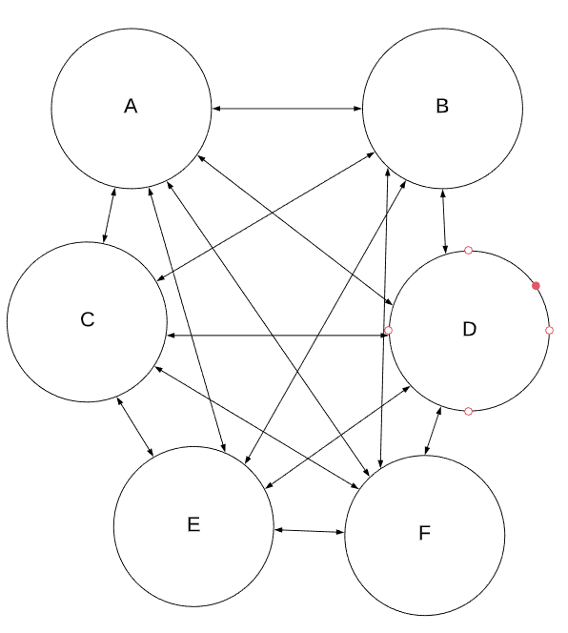
Point-to-Point
Each application sends and receives data from other applications
Usually need to be custom-made for each pair of applications
Usually pretty quick and simple for small number of apps
Rapidly devolves into a mess with too many apps
# of integrations grows O(n²)

Slide 4
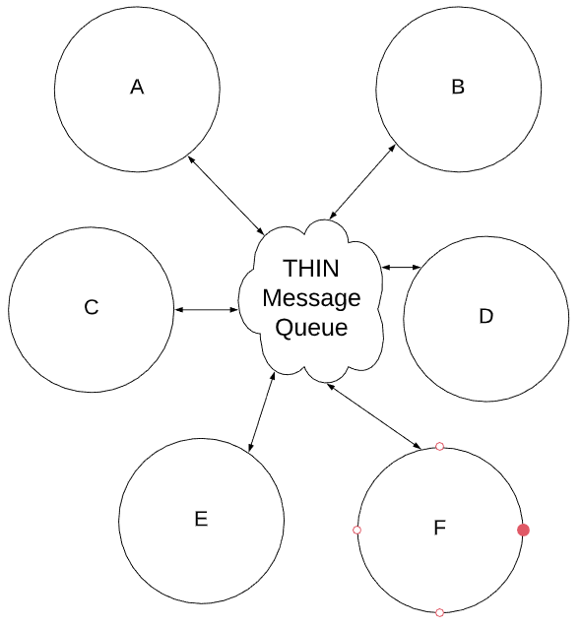
Hub-and-Spoke
Hub-and-Spoke
A central orchestrator sends and receives all data
Each App integrates with the central orchestrator
Applications are abstracted from each other
# of integrations grows O(n)

Slide 5
Build Your Own iPaaS
Helpful to learn your integration needs and determine your needs for a full iPaaS
Can be built in a “Serverless” way
Example here is built in AWS, however the same functionality exists in all major public cloud providers (GCP, Azure)
Ours is called “THIN” (TeamHealth Integration Network)

Slide 6
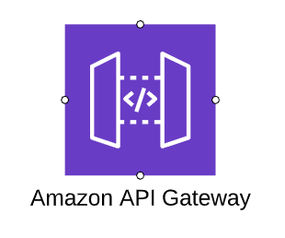
Elements of THIN (AWS Components)
API Gateway
Used for receiving web communications
Very affordable, no server infrastructure
Works with HTTPS for secure communications
Default support for API Keys for authentication, can build custom authentication

Slide 7
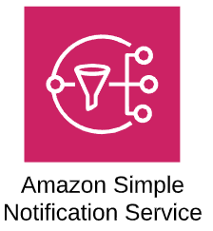
Elements of THIN (AWS Components)
Simple Notification Services (SNS)
Used for “fan out” of messages
Each message is passed to one or more “subscribers”
Receivers can be:
Email
SMS
Queues
Functions
More

Slide 8
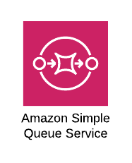
Elements of THIN (AWS Components)
Simple Queuing Services (SQS)
Reliable message delivery
Each message received is processed once
Can be configured for polling (pull) or to push messages once received
Support batching of messages and retry of failed messages

Slide 9
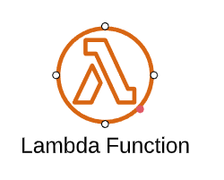
Elements of THIN (AWS Components)
AWS Lambda
The heart of your serverless architecture
Allows you to deploy code to AWS Cloud
Pay only for runtime/memory allocation, no cost for idling
Scales automatically, more requests = more compute
Multiple languages: C#, Java, Node.js, Python, Ruby, Go
Triggered from API Gateway, SNS or SQS

Slide 10
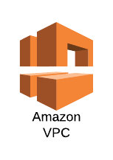
Elements of THIN (AWS Components)
Virtual Private Cloud (VPC)
The networking that your systems run on
Can configure a direct VPN from AWS to your site (so systems elements can run “behind the firewall)
Segregate your systems so only those that need direct access are behind the firewall, others are outside
Strict control of access between systems as well (microsegmentation)

Slide 11
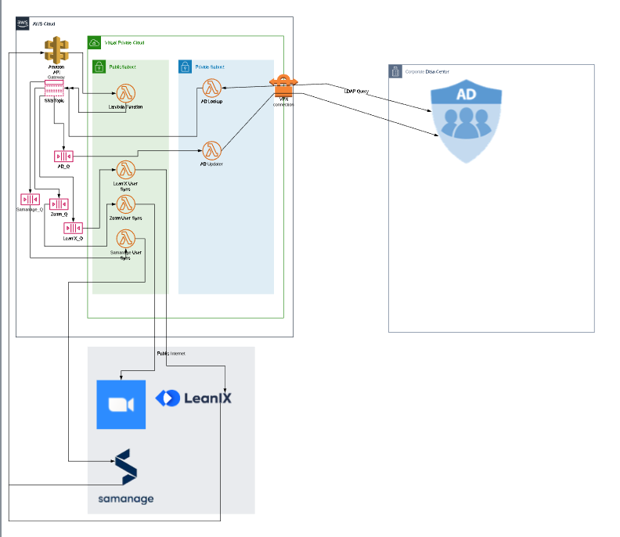
Walk-through

Slide 12
Implementing Hub-and-Spoke
iPaaS
Integration Platform As A Service
Industry examples:
Jitterbit
Mulesoft
Informatica
Dell BOOMI
These all create links from the iPaaS to each application
Significantly Simpler setup, less code

Slide 13
Questions
Slides available at

